Slide 1
Command Design Pattern
Presented By :
Name : Gajera Shradhdha Vinodbhai
Enrollment No. : 12008142
Name : Pethani himanshi Arvindbhai
Enrollment No. : 12008147
Guide By :
Ajay Parikh

Slide 2
what is it ?
Command design pattern is a data driven design pattern and falls under behavioral pattern.
A Command Pattern says that "encapsulate a request under an object as a command and pass it to invoker object.

Slide 3
Intent
• Encapsulate a request as an object, thereby letting you parameterize clients with different requests, queue or log requests, and support undoable operations.

Slide 4
Receiver Object
Sender Object
Request
Also Know As
Action , Transaction

Slide 5
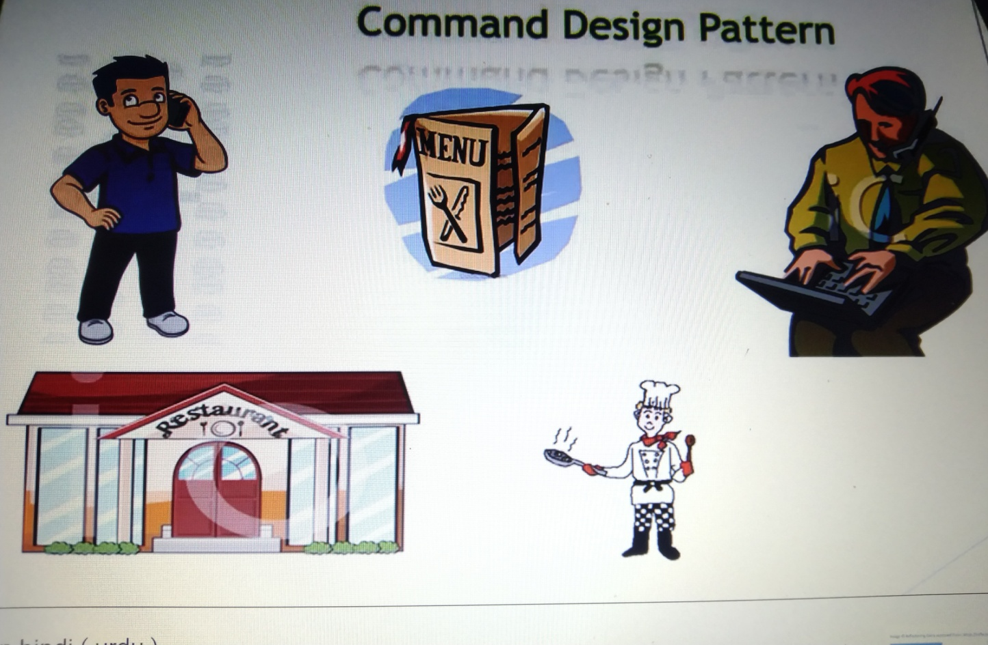
Real Life Example
Order : Command
Customer : Client
Cook : Receiver
4. Waiter : Invoker

Slide 6
problem
If there is no waiter then the problem arises. Who should I give the order to ?
Solution
What is a middle man who knows me and also knows cook.
Here loose coupling is said to have happened.

Slide 7
Applicability
Use of command pattern when :
You want to parametrize objects with operations
You want to queue operations, schedule their execution, or execute them remotely

Slide 8
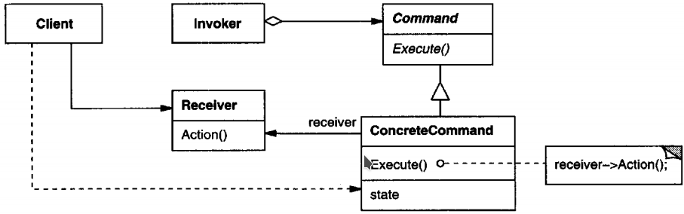
Structure Diagram of Command Pattern

Slide 9
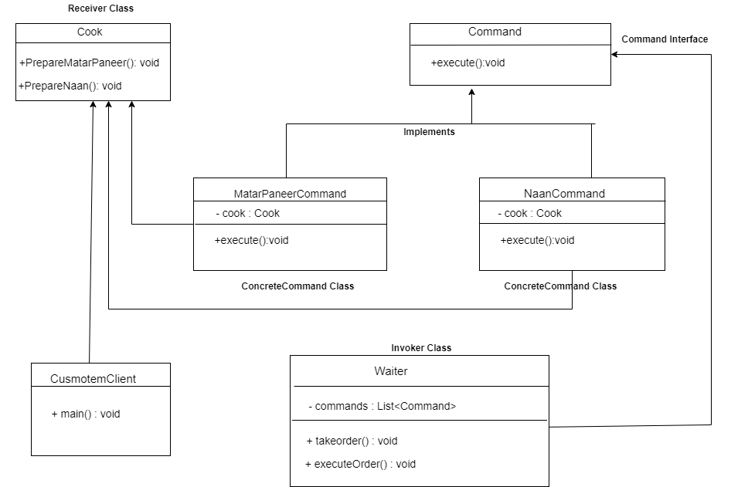
Class Diagram of Command Pattern

Slide 10
Participants of command pattern
Command : This is an interface for executing an operation.
ConcreteCommand : That class implement the command interface.
Client : This class creates concrete command objects.

Slide 11
Invoker : This class is responsible for initiating requests.
Receiver : This class contains some business logic.

Slide 12
Advantage of command pattern
It makes easy to add new commands, because existing classes remain unchanged.
You are able to transfer data as an object between system components.

Slide 13
disadvantages of Command pattern
There are a high number of classes and
objects working together to achieve a goal.
Every individual command is a ConcreteCommand class that increases the volume of classes implementation and maintenance.

Slide 14
Questions
1. Command design pattern comes in which design pattern category ?
2. Command pattern also known as .....
3. Which are three main class in command pattern ?
4. Give real example of command design pattern .
5. Which class contains business logic?

